Slide 1
Neural population dynamics during reaching
Details of paper
Churchland M M, Cunningham J P, Kaufman M T, et al. Neural population dynamics during reaching[J]. Nature, 2012, 487(7405): 51-56.
01

Slide 2
Neural population dynamics during reaching
Motivation
Form a new perspective to see the motor cortex
Assumption
Traditional assumption
motor cortex may constitute a dynamical system that generates and controls movement
Conclusion
motor cortex responses during reaching contain a brief but strong oscillatory component, something quite unexpected for a non-periodic behavior .
Rotations of the population state are a prominent feature of the cortical response during reaching.
02

Slide 3
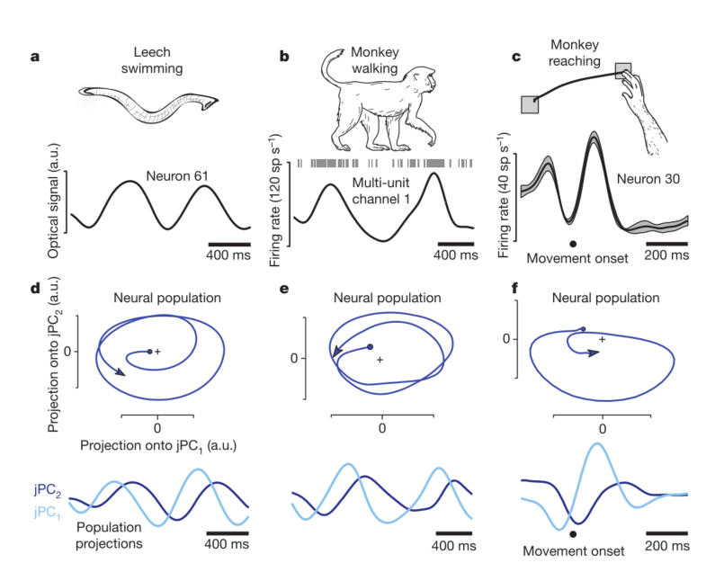
Neural population dynamics during reaching
Rhythmic responses in different systems
Population-level dynamics
jPCA
time-invariant linear dynamical system
03

Slide 4
上周总结
Skew-symmetric matrices
Mapping to vector product
Decompose to rotation matrix
PCA on skew-symmetric matrices and rotation matric
Get com plex conjugate pairs eigenvectors
02

Slide 5
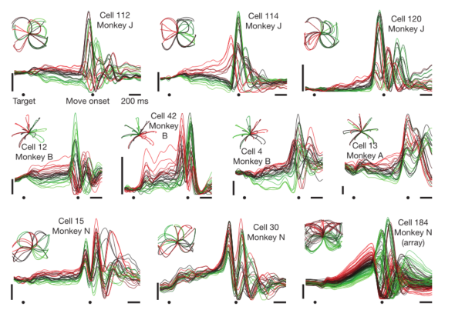
Neural population dynamics during reaching
Quasi-rhythmic responses during reaching
there appear to be oscillations in many single neuron responses, beginning just before movement onset
whether there exists orderly rotational structure across conditions
01

Slide 6
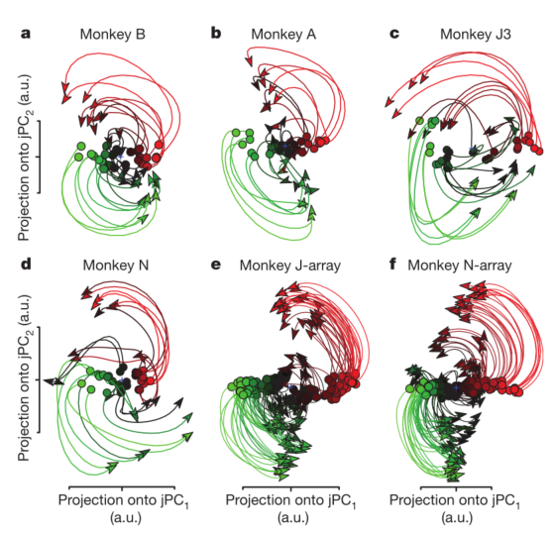
Neural population dynamics during reaching
jPCA Result
rotations of the neural state are prevalent during reaching
the neural state rotates in the same direction across conditions
state-space rotations do not relate directly to reach curvature.
01

Slide 7
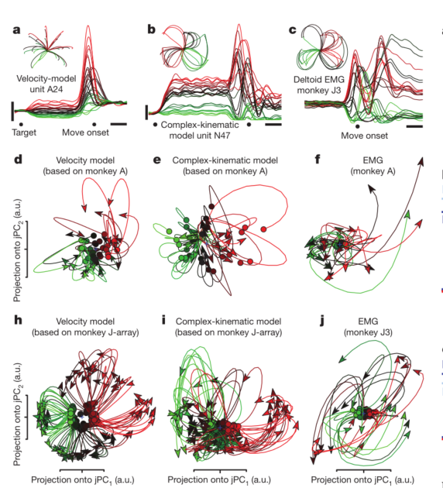
Neural population dynamics during reaching
Rotations, kinematics and EMG
Traditional views posit that motor cortex neurons are tuned for movement parameters does not naturally account for the data
velocity model , complex-kinematic model don’t hold robust or consistent rotations
recorded EMG (electromyograms) from a population of muscles did not show consistent rotations
01

